Slide 1
Chaos game representation of diseases and genomic analysis
INTRODUCTION TO BIOLOGICAL SYSTEMS-1
(22BIO201)
Team Members:- Aadith Krishna CB.SC.U4AIE23202 Arjun Gopal CB.SC.U4AIE23271 Aditya Santosh CB.SC.U4AIE23207
Abhisek Pandey CB.SC.U4AIE23205

Slide 2
INTRODUCTION
The COVID-19 pandemic has emphasized the importance of efficient genomic analysis for understanding viral structures and evolution. Our project utilizes Chaos Game Representation (CGR), a fractal-based method, to visually and quantitatively analyze the COVID-19 genome.
By converting sequences into CGR plots and matrices, we can identify structural patterns that differentiate COVID-19 from other genomes.
Additionally, k-mer and clump analysis further enhance this study by highlighting frequent sequence patterns and motifs within the genome.
By comparing CGR matrices and analyzing k-mer distributions, our project aims to reveal unique genomic features of COVID-19, potentially offering insights into viral evolution and aiding in genomic comparison techniques.

Slide 3
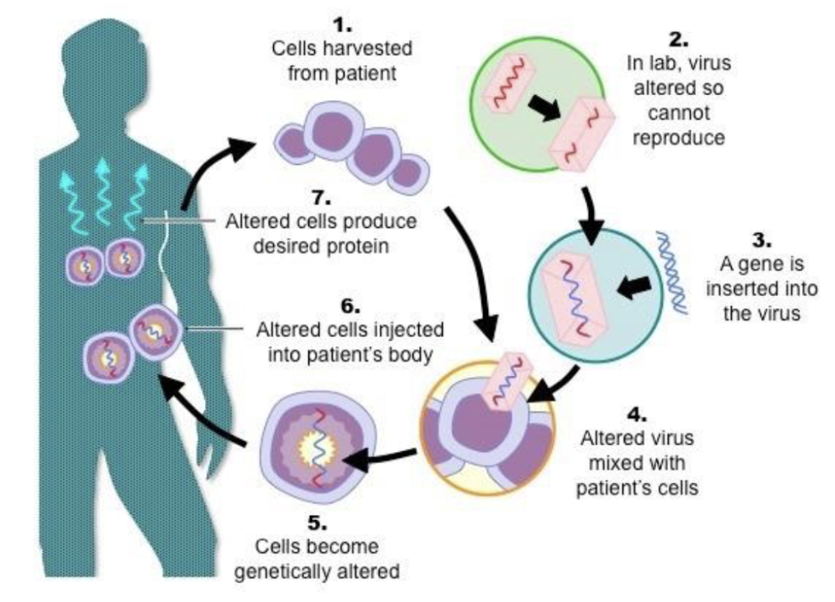
Origin of replication(ori)
The origin of replication (ori) is a specific DNA sequence where DNA replication begins.
The ori is important for cell division and virus reproduction.
In bacteria like E. coli, the ori site binds initiator proteins to start the replication process.
Viruses often depend on the host cell’s machinery to help them replicate.
DNA viruses have specific sequences that act as origins, which they use to begin replication with the host's help.
RNA viruses (like SARS-CoV-2) don’t use a traditional ori. Instead, they use an enzyme called RNA-dependent RNA polymerase to copy their RNA.
Studying origins of replication is useful in disease research. It helps scientists find targets for therapies and understand how pathogens (like bacteria and viruses) survive and replicate within their hosts.

Slide 4

methodology
1. Data Collection
Genome Selection: Obtain high-quality, complete genome sequences of SARS-CoV-2 (COVID-19) and other related viral genomes from a reliable database such as NCBI GenBank or GISAID.
Pre-process the sequences to remove any unwanted characters or incomplete sections to ensure consistency in the analysis.
2. Chaos Game Representation (CGR) Plot Generation
CGR Setup: Create CGR plots for each genome. Define a square plot with each vertex representing one nucleotide (A, T, C, G).
Point Mapping: Starting from the plot’s center, iteratively map each nucleotide in the sequence by moving halfway from the current point toward the vertex corresponding to the next nucleotide.
Visualization: Generate CGR plots for each genome sequence, using plot density to indicate nucleotide distribution and structural patterns in the sequences.

Slide 5
3. CGR Matrix Construction and Comparison​
Matrix Creation: Convert each CGR plot into a matrix, where each cell represents a specific coordinate in the plot. The matrix values indicate the density or frequency of points, capturing the spatial distribution of the genome.​
4.Matrix Comparison: Calculate similarity between CGR matrices using techniques like Euclidean distance, correlation coefficients, or percentage similarity, allowing for quantitative assessment of structural similarities and differences among genomes.​
5. K-mer and Clump Analysis​​​
K-mer Extraction: Segment each genome sequence into k-mers (overlapping substrings of fixed length, e.g., k=3 or k=4). This captures short sequence patterns and motifs within the genome.​​​
Clump Identification: Identify high-frequency k-mers and locate clumps—regions where specific k-mers recur frequently within short sections. Clumps may suggest functional or regulatory motifs within the genome.​​​

Slide 6
​
5. Analysis and Interpretation​​
Structural Comparison: Analyze CGR plots and matrices to identify patterns or clusters unique to COVID-19. Compare these with other viral genomes to understand similarities and differences.​​
Accuracy Validation: Validate the accuracy of similarity measurements by comparing known relationships between sequences or aligning results with existing genomic studies.​​

Slide 7
KMER
K-mers are substrings of length k in a given string in simple terms (can be DNA, RNA, protein, or any string sequence).
For example, the 11-nucleotide DNA sequence "ACGAGGTACGA." Let's see if we can find all of the 4-mers (four-letter substrings) in this DNA sequence.
If length of DNA sequence is ‘N’ then we get (N - k+1) k-mers
In the above case N=11, k=4, so total k-mers we have is 11-4+1=8 k-mers

Slide 8
MOST FREQUENT KMER
If Pattern maximises COUNT(Text, Pattern) among all k-mers, it is said to be the most frequent k-mer in the Text.
The most common 5-mer for Text = ACAACTATGCATACTATCGGGAACTATCCT is ACTAT.
Whereas the most common 3-mer for Text = CGATATATCCATAG isATA.
N=11, k=4; 11-4+1=8.

Slide 9
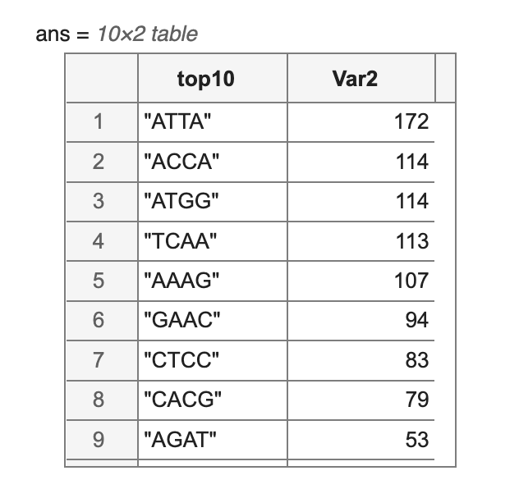
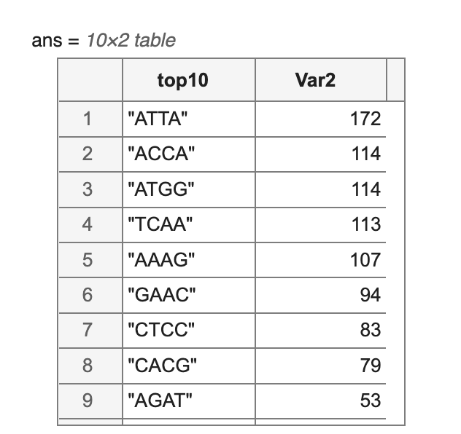
Clumps
If a k-mer appears multiple times within a brief interval of the genome, it is considered a "clump." In more technical terms, if there is an interval of Genome of length L in which this k-mer appears at least t times, a k-mer Pattern creates a (L, t)-clump inside a (longer) string Genome.
SARS-CoV-2 genome
Sample genome

Slide 10
Cgr representation
For DNA sequences, the CGR approach was presented as a unique and scale-independent representation. Fractal landscapes are created by mapping the genomic sequence using the frequency chaos game representation (FCGR).
This iterative mapping technique assigns a unique coordinate in a 2-dimensional space to each nucleotide in DNA or amino acid in a protein (x, y).
This two-dimensional graphic depicts the distribution of dots as a 0– 1 square matrix, with 0 representing an empty coordinate and 1 representing a dot. As a result, a point represents an element in the nth position of the DNA sequence (Seq = S1, S2,..., SL) made of L nucleotides (A, T, C, or G).
This point is continually plotted midway between the previous plotted point and the segment connecting the read letter Sn's vertex.

Slide 11

ALGORITHM
1.Input: a genomic sequence with length N
2.Intialize step: creating a square with each corner:
Adenine (A) with coordinates (xA =0,yA=0)
Thymine(T) with coordinates (xT=1, yT=0)
Cytosine(T) with coordinates (xC=0, yT=1)
Guanine(T) with coordinates (xG=1, yG=1)

Slide 12
3.starting point :X0 (x0=0.5 ,y0=0.5)
4) case 1 A: place the dot at 𝑋1=0.5(𝑥𝐴+𝑥0) ;𝑌1=0.5(𝑦𝐴+𝑦0) ; T: place the dot at 𝑋1=0.5(𝑥𝑇+𝑥0) ;𝑌1=0.5(𝑦𝑇+𝑦0) ; C: place the dot at 𝑋1=0.5(𝑥𝐶+𝑥0) ;𝑌1=0.5(𝑦𝐶+𝑦0) ; G: place the dot at 𝑋1=0.5(𝑥𝐺+𝑥0) ;𝑌1=0.5(𝑦𝐺+𝑦0) ;
End Case For the other nucleotides : from 2: N Case is A: place the dot at 𝑋𝑖=0.5(𝑥𝐴+𝑥𝑖−1) ;𝑌𝑖=0.5(𝑦𝐴+𝑦𝑖−1) ;
T: place the dot at 𝑋𝑖=0.5(𝑥𝑇+𝑥𝑖−1) ;𝑌𝑖=0.5(𝑦𝑇+𝑦𝑖−1) ;
C: place the dot at 𝑋𝑖=0.5(𝑥𝐶+𝑥𝑖−1) ;𝑌𝑖=0.5(𝑦𝐶+𝑦𝑖−1) ;
G: place the dot at 𝑋𝑖=0.5(𝑥𝐺+𝑥𝑖−1) ;𝑌𝑖=0.5(𝑦𝐺+𝑦𝑖−1) ;
EndFor

Slide 13
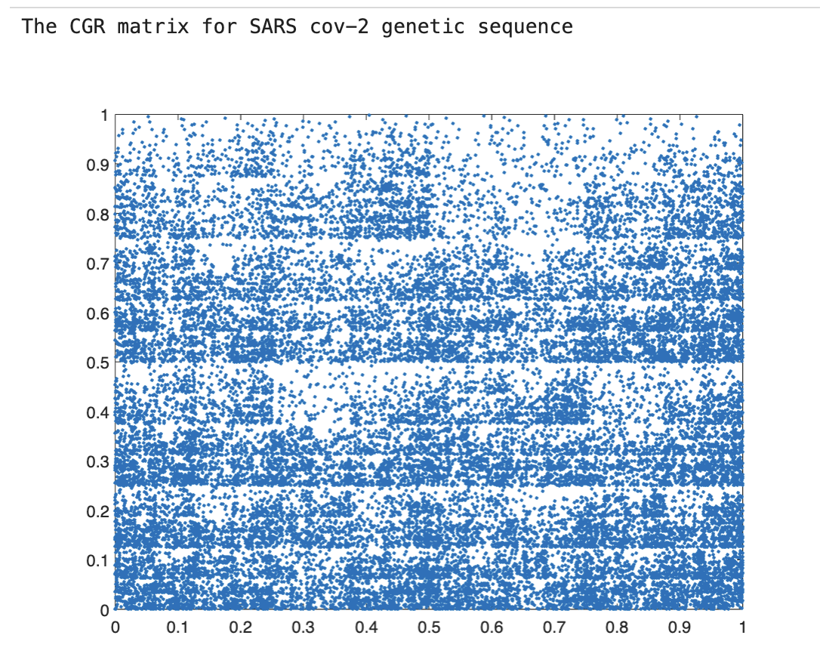
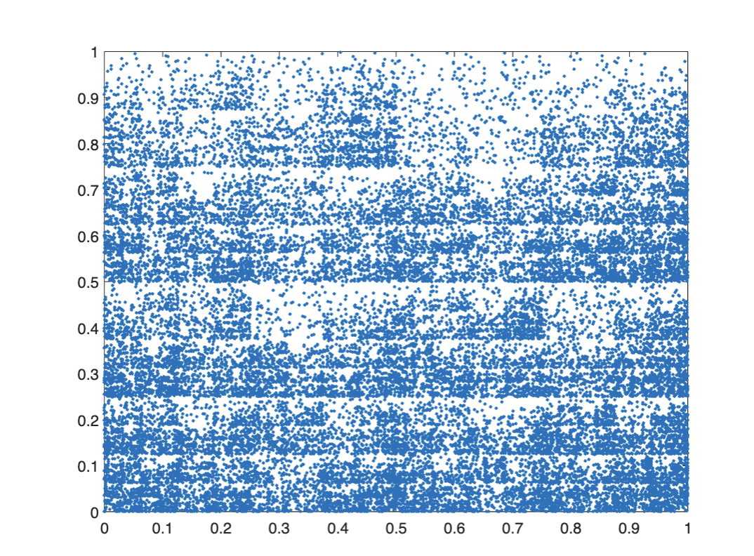
RESULTS

Slide 14
CONCLUSION
The findings demonstrate that the sample genomic sequence is closely related to SARS-CoV-2, with 90.9 percent identity across the genome,

Slide 15
THANK YOU

